Slide 1

Energy Analysis of Underground Coal Gasification with Simultaneous Storage of Carbon Dioxide
x
Ali Akbar Eftekhari
Hans Bruining

Slide 2
(Enriched) Air
Exergy Analysis
CO, CO₂, H₂,
H₂O, CH₄, N₂
Water (Steam)
C + 2 H₂O + CaO ←→ CaCO₃ + 2 H₂ + 87.9 kJ/mol
Mathematical and
Thermodynamic models

Slide 3
Exergy Analysis of Energy Recovery Processes
CO₂ Capture and Storage Energy
CO₂ Capture and Storage
CO₂ Capture and Storage
Recovery Process Energy Consumption
Recovery Process Energy Consumption
Recovery Process Energy Consumption
Energy Source

Slide 4
Zero-emission recovery factor
Natural Gas (62%)
Coal (56%)
Ref: Dellucci, 2003;
Except the CCS data

Slide 5
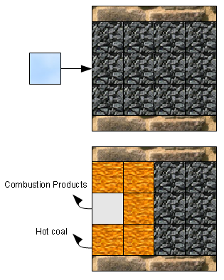
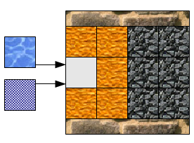
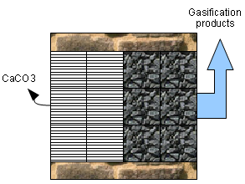



UCG with mineral injection
High Temperature:
CaCO3 ←→ CaO + CO₂
Volume Constraint:
5

Slide 6
Independent reactions
Combustion
C + O₂ → CO₂ + 393.77 kJ/mol
Gasification
Global reaction
C + 2 H₂O + CaO ←→ CaCO₃ + 2 H₂ + 87.9 kJ/mol
Boudouard reaction
C + CO₂ ←→ 2 CO – 172.58 kJ/mol
Shift reaction
CO + H₂O ←→ CO₂ + H₂ – 41.98 kJ/mol
Methanation
C + 2 H₂ ←→ CH₄ + 74.90 kJ/mol
Exothermic
Endothermic
Very Slow

Slide 7
Equilibrium relations
y_{i}: gas phase mole fraction
P⁰: standard pressure (1 bar)
P: system pressure
K_{j}: equilibrium constant of reaction j
v_{i,j}: stoichiometric coefficient of component i in reaction j
Φ_{i}: fugacity coefficient of component i in a gas mixture

Slide 8
Temperature constraint at P=80 bar
Volume constraint

Slide 9
Optimum composition (O₂ injection)
 | Composition (dry basis)
H2 | 0.46
CO2 | 0.08
CO | 0.32
CH4 | 0.14
Higher heating value (MJ/m³) | 14.679
Lower heating value (MJ/m³) | 13.286

Slide 10
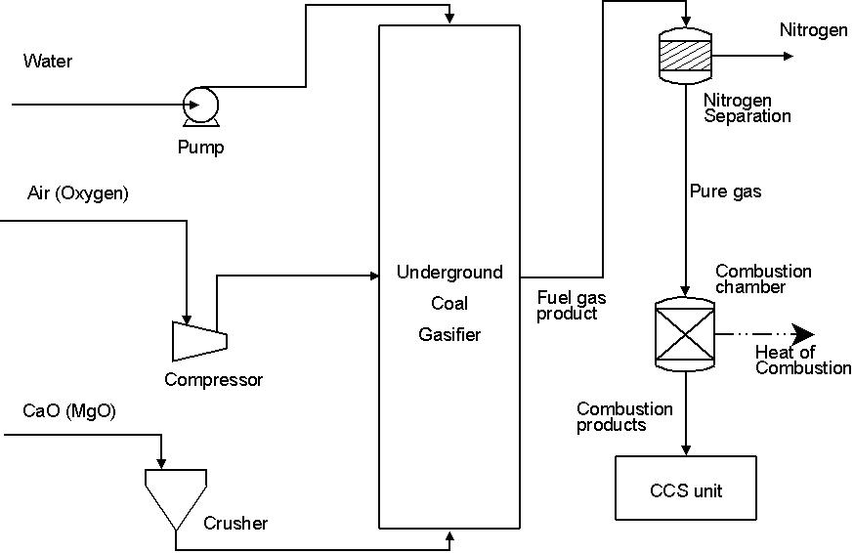
Process flow diagram (1)
E₅
E₁
E_{Res}
E₂
E_{gain}
E₄
E_{CCS}
E₃
η = (E_{gain} - (∑E_{i} +E_{CCS} ))/E_{Res}

Slide 11
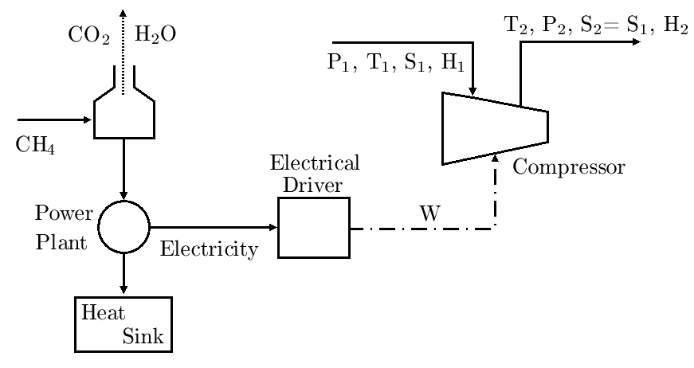
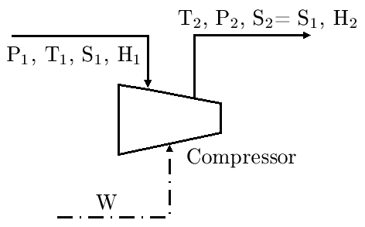
From theory to practice
Zero-emission
(Sustainable)
Theoretical
Practical

Slide 12
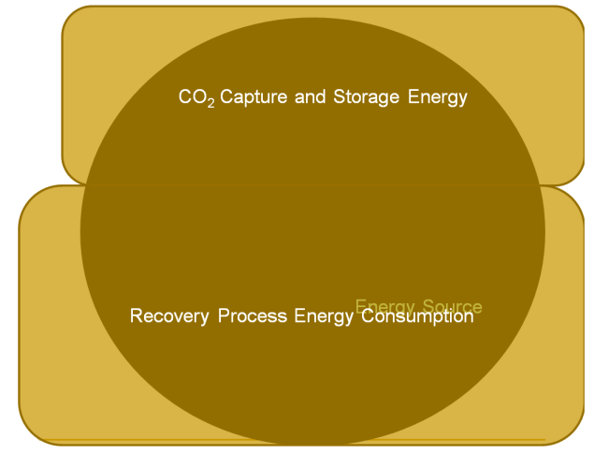
Results of PFD (1)
Recovery
factor (%)
Theoretical, practical, and zero-emission recovery of coal energy (water to oxygen molar ratio of 3.2)

Slide 13
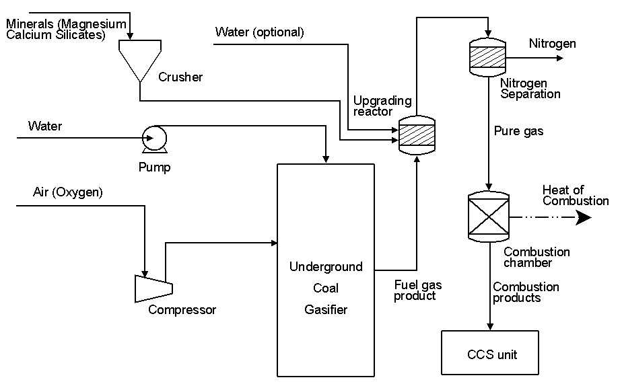
Process flow diagram (2)

Slide 14
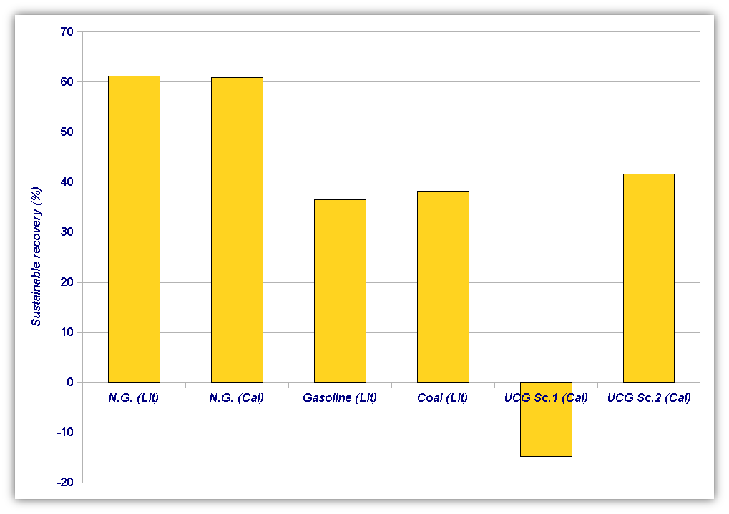
Sustainable recovery for other energy conversion processes

Slide 15
Conclusion
In situ introduction of absorbent e.g. CaO is energetically expensive and with the current state of technology is not feasible
Using naturally abundant minerals can improve the exergetic recovery of UCG process

Slide 16
Coal Zero-emission Recovery

Slide 17
Natural gas sustainable recovery

Slide 18


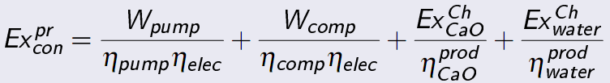
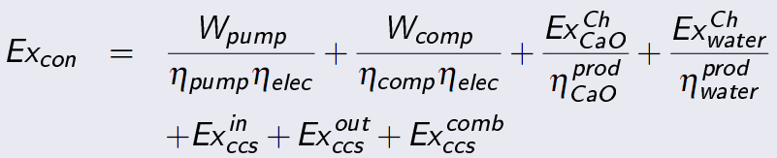
Formulation

Slide 19
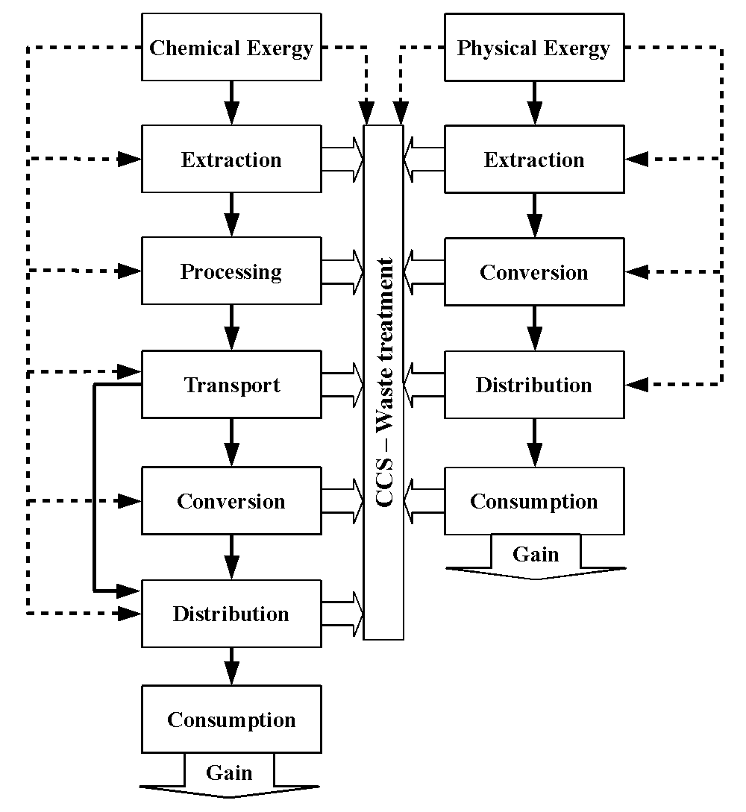

Slide 20
Exergy?
Energy = Exergy + Anergy
Exergy is a portion of energy that potentially can be converted to mechanical work
1 kJ of Electricity =
1 kJ of Exergy + 0 kJ of Anergy
1 kJ of energy in hot water at 70ºC =
0.13 kJ Exergy + 0.87 Anergy
Energy is conserved; Exergy is consumed

